Slide 1
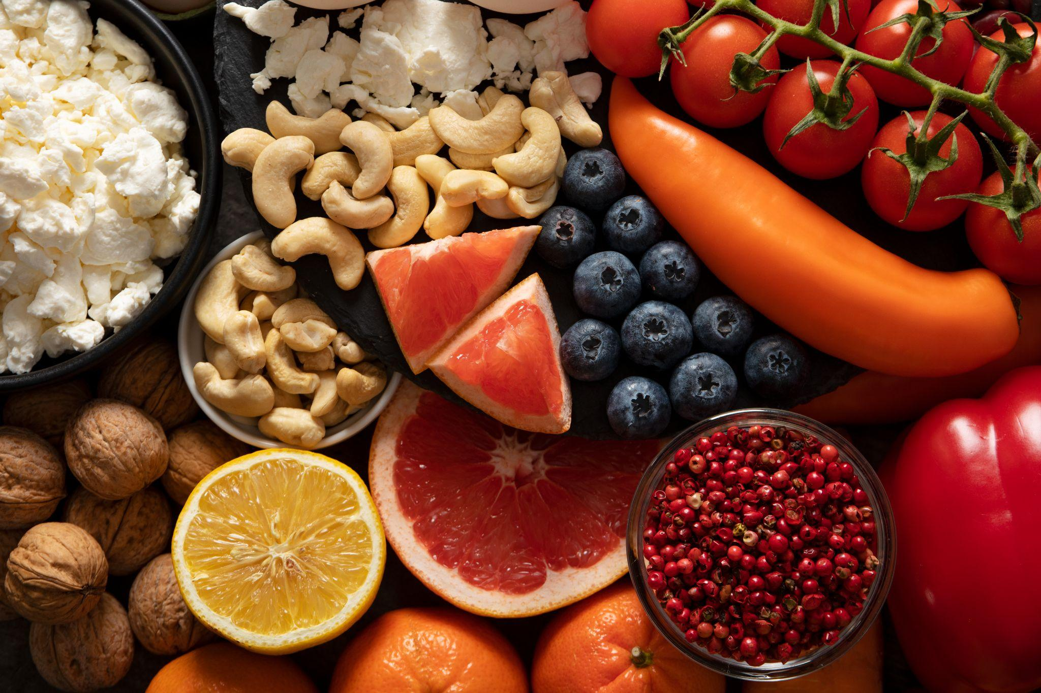

Impact of Global Income Disparities on the Cost and Affordability of Healthy Diets: An Analysis of Dietary Choices among Income Groups and Their Correlation with Obesity. Project One – Group 3 October 22, 2024

Slide 2
Table of contents
01
02
03
04
05
06
Introduction
Objective
Group 3 members
Research Questions
Methodology
Analysis
Conclusions
Datasets obtained, data explored and cleaned
Present visualizations to answer research questions
Draw conclusions based on analysis

Slide 3
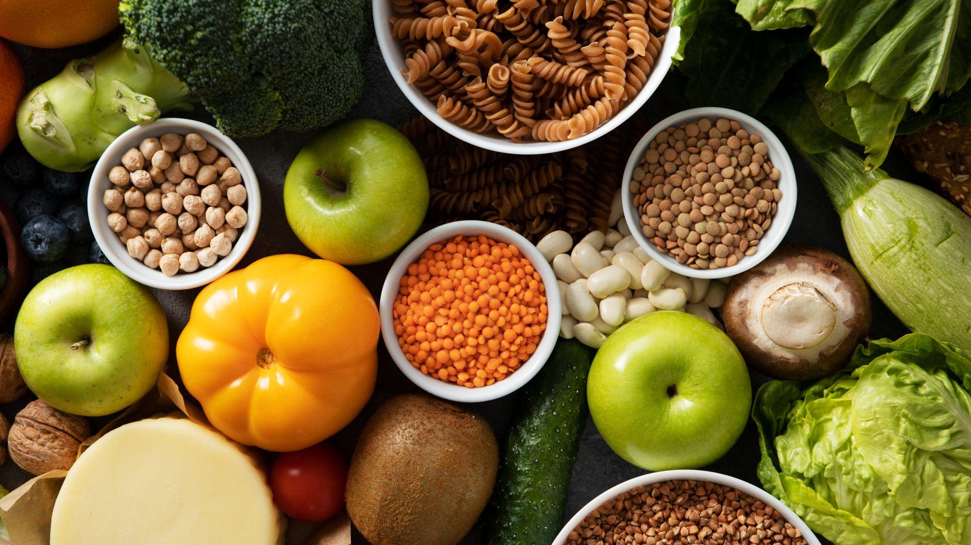
01
Introduction

Slide 4

—Mahatma Gandhi
“"It is health that is real wealth and not pieces of gold and silver."

Slide 5
Team Members – Group 3
Sunil
Gabriel
Janette
Felipe

Slide 6
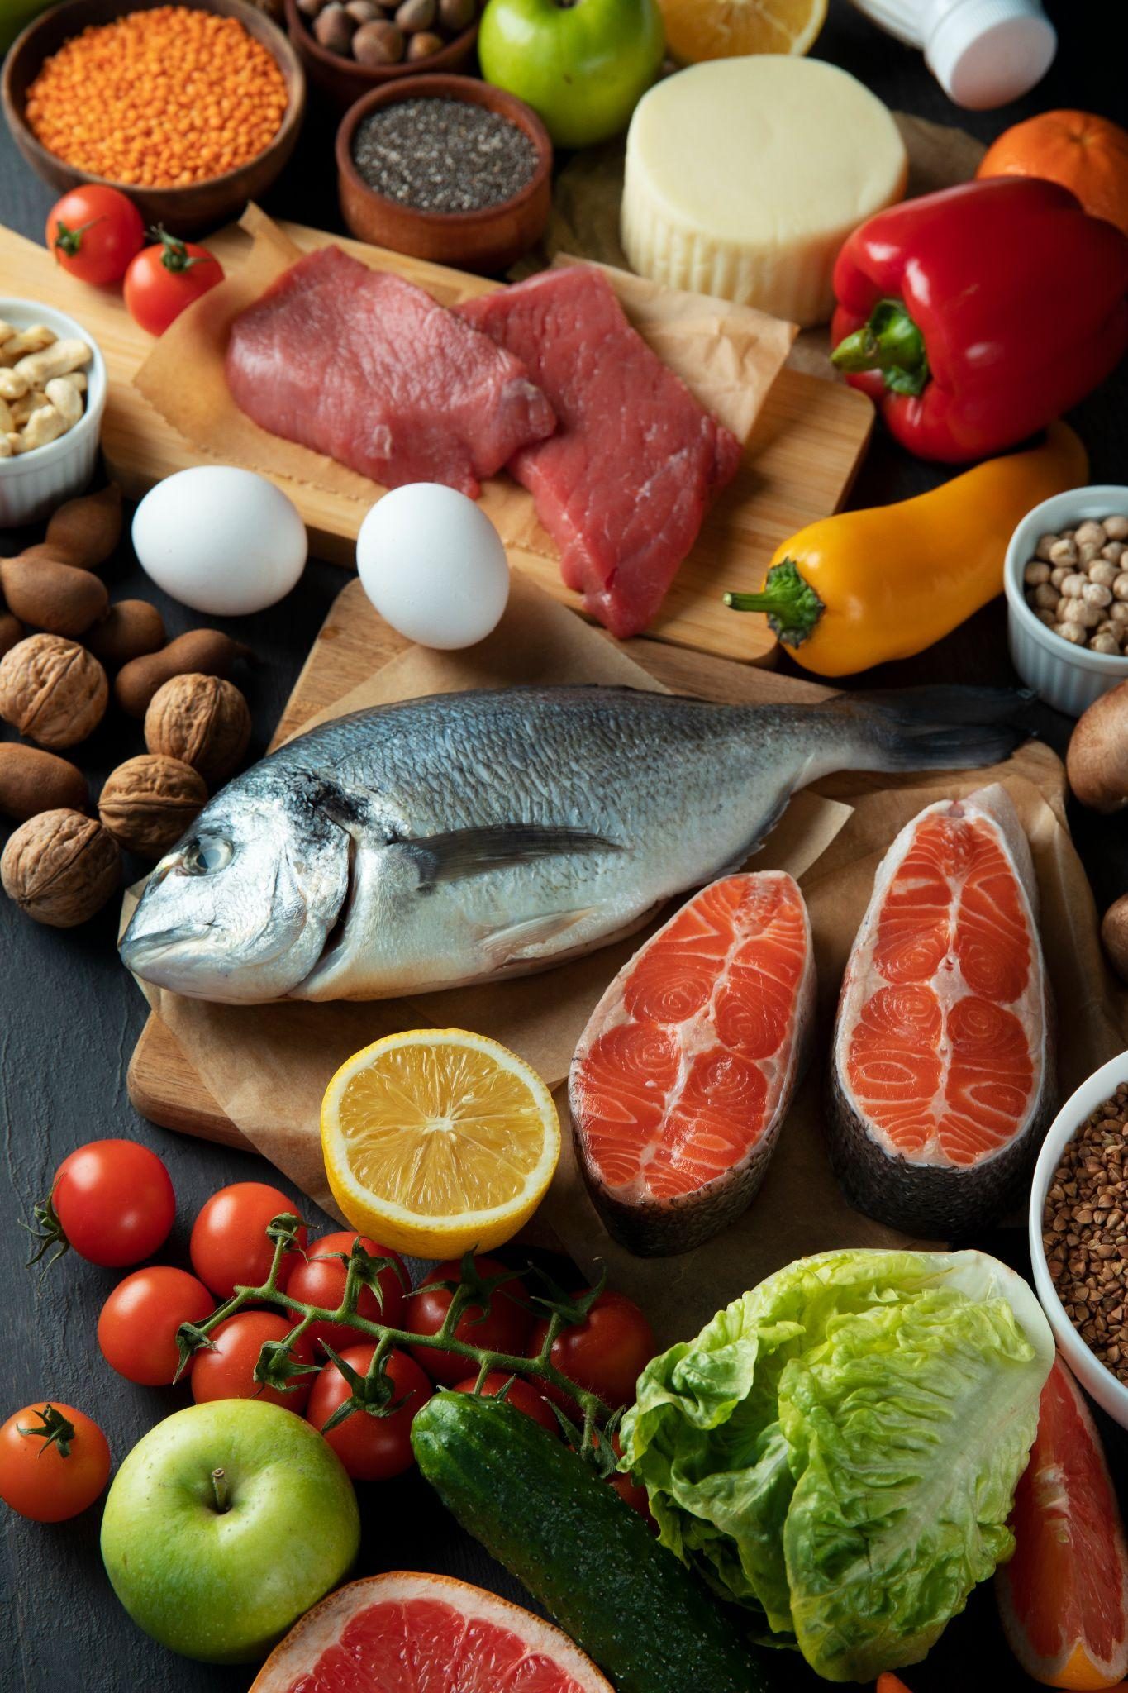
Objective
02

Slide 7


This project aims to explore the relationship between population GDP and the cost and affordability of healthy diets, and analyze variations across different income groups.
Objective
Furthermore, it will investigate the correlation between these dietary choices and obesity across different regions. The ultimate goal is to provide insights for policymakers to promote healthier eating habits.
Note that images used on this slide have been properly obtained and reference properly made to source

Slide 8

03
Research Questions

Slide 9
Research Questions
How does the affordability of healthy diets vary by income group?
01
What is the relationship between global income levels and the cost of healthy diets?
02

Slide 10
Research Questions
How do the costs of different dietary choices vary among high, middle, and low-income populations in 2017?
03
How does a person's income level influence the types and amounts of food they typically consume?
04

Slide 11
Research Questions
Is there a significant correlation between the unaffordability of healthy diets and the prevalence of obesity rates in different countries?
05
Is there a correlation between global income levels and obesity rates?
06

Slide 12

04
Methodology

Slide 13
Methodology
Data Collection (Datasets)
Global income statistics
Cost and Affordability of a Healthy Diet - FAOSTAT
Obesity - WHO NCD Data Portal
Data Integration
Datasets 1 & 2 merged through lists (Country and Income Group)
Data Cleaning and Preparation
Missing Values
Dropna
Created DataFrames
Eliminated and Renamed Columns
Data Standardization
Visualization and Analysis

Slide 14

05 Analysis
Visualization and Analysis

Slide 15
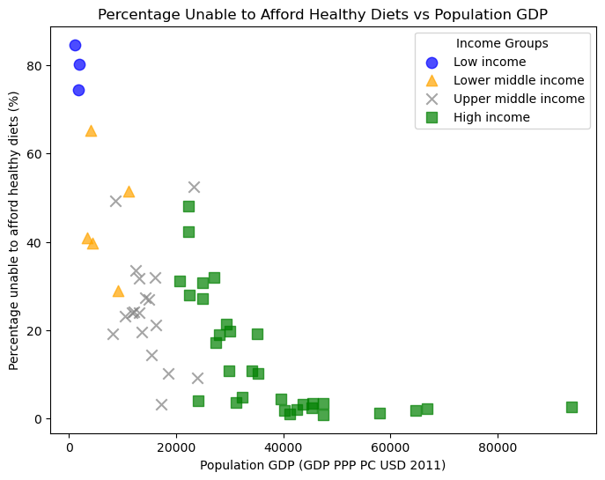
Q1: How does the affordability of healthy diets vary by income group?
As the population’s GDP increases
The percentage of the population unable to afford healthy diets decreases
More people can afford healthy diets in high-income countries
The r²-value is 0.481
Moderate correlation

Slide 16
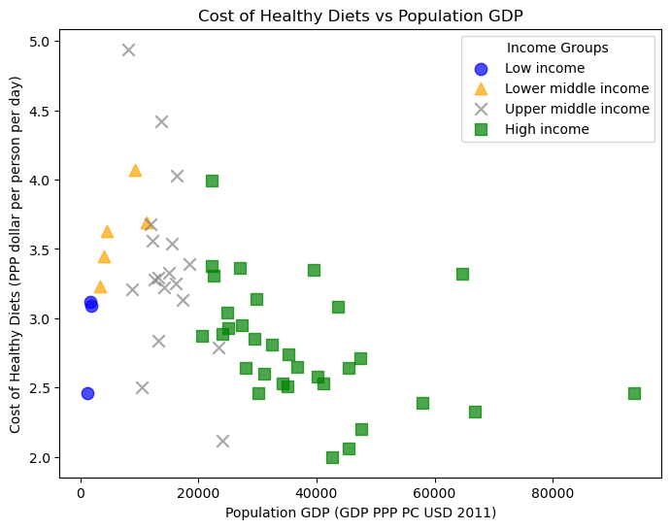
Q2: What is the relationship between global income levels and the cost of healthy diets?
Considerable variation in the cost across different countries, even within the same income group
The cost of healthy diets tends to be a relatively smaller part of people’s income in high-income countries
The r²-value is 0.277
Weak correlation

Slide 17
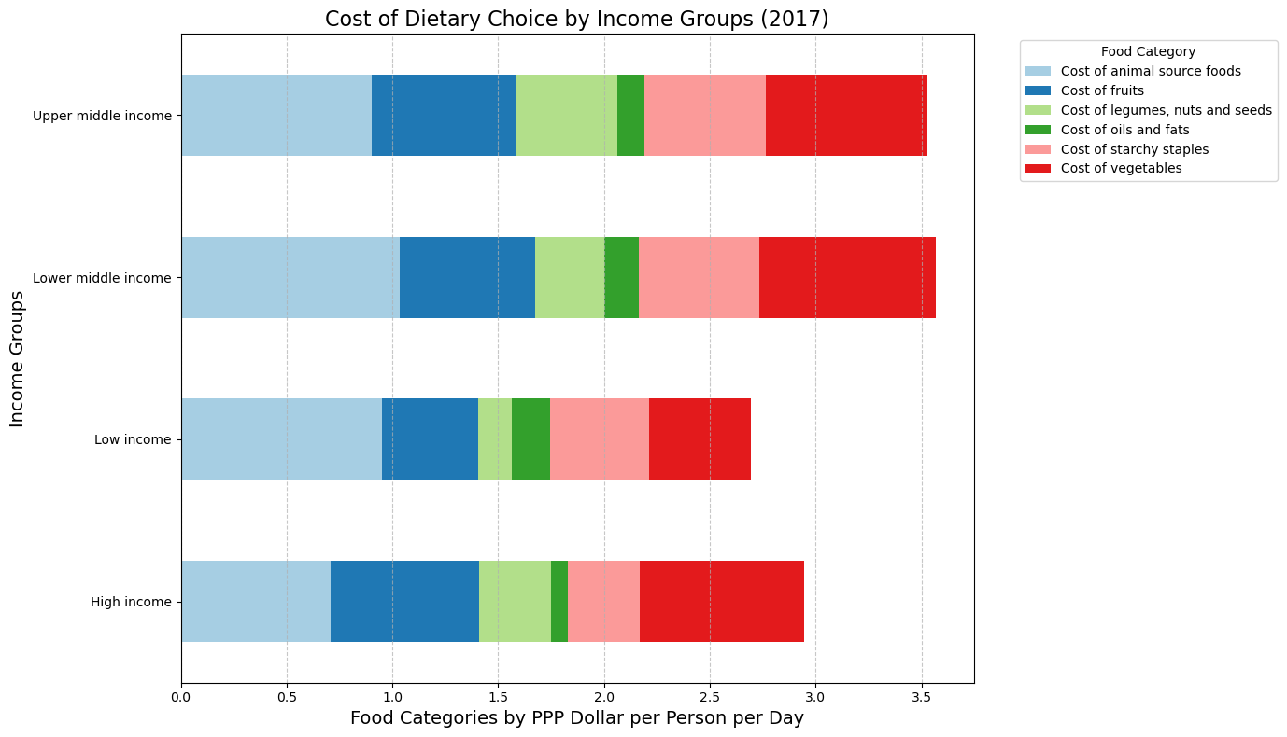
Q3: How do the costs of different dietary choices vary among high, middle, and low-income populations in 2017?
Shows dietary choices by Income groups using the Purchasing Power Parity [PPP] Dollar per Person per day factor
Key Observations:
Cost of animal source of foods takes up a significant portion of LMI
Cost of vegetables takes up a smaller portion of the spending from Lower income countries

Slide 18
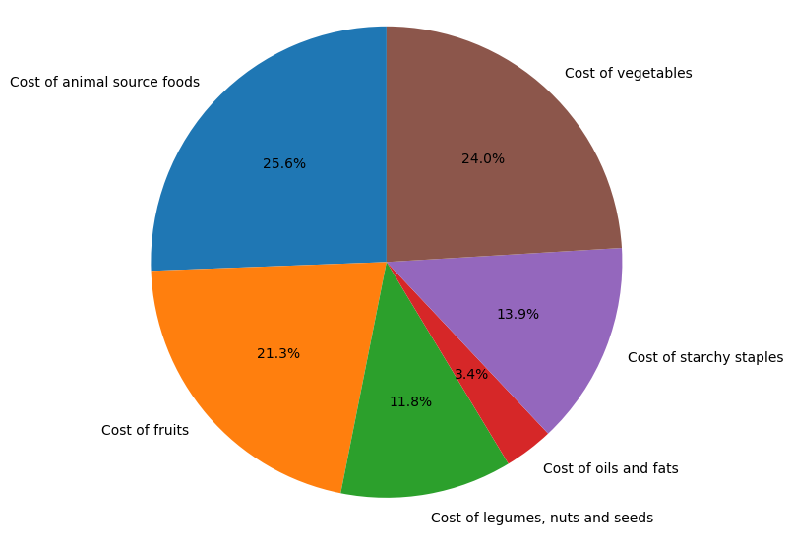
Q4: How does a person's income level influence the types and amounts of food they typically consume?
GENERAL DISTRIBUTION OF FOOD COSTS 2017
It does affect in a several way where the consumer decision is based on budget and not with a nutritional focus.
The cost impact of animal-based foods on household food budgets worldwide is also highlighted by this data, along with the significance of a balanced diet on a global scale.

Slide 19
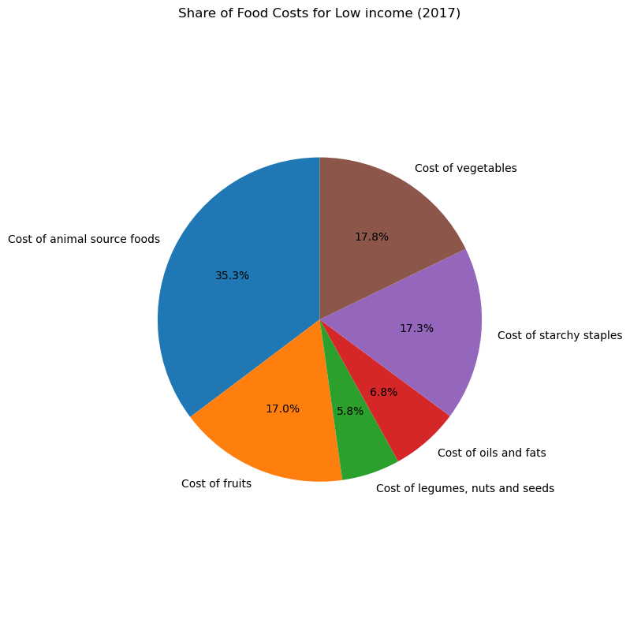
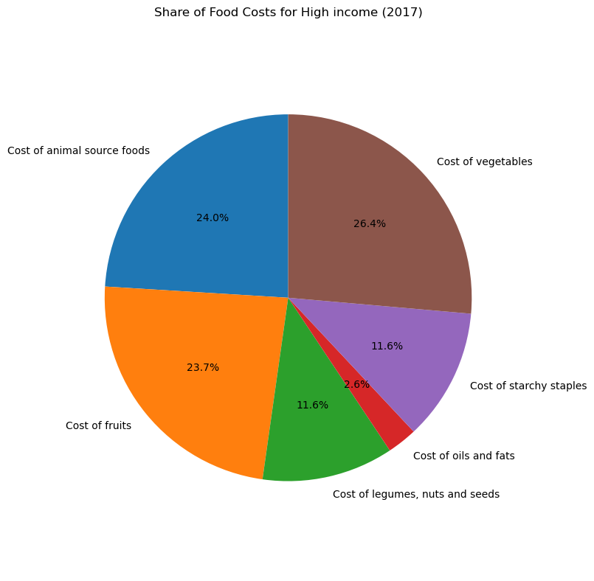
LOW INCOME
HIGH INCOME
This data shows the difference between low income food consumption distribution and high income consumption distribution. It shows how the money is the main factor at the time to choose a diet.

Slide 20
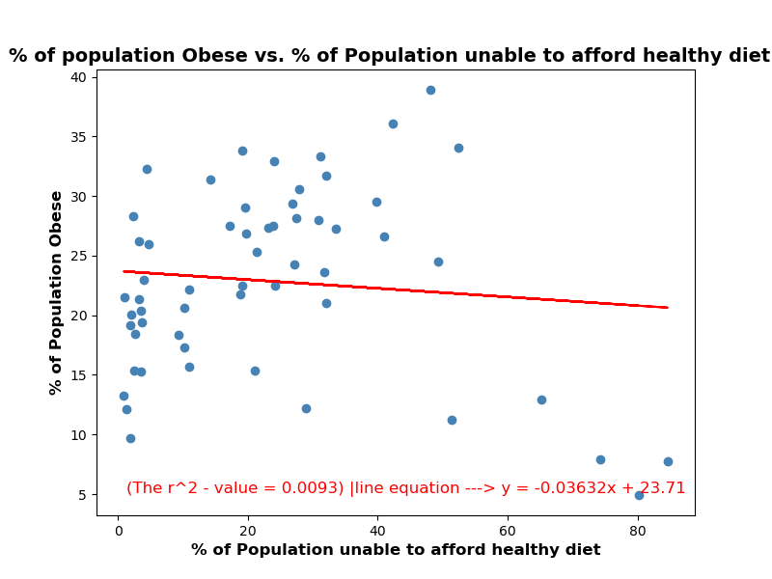
Q5: Is there a significant correlation between the unaffordability of healthy diets and the prevalence of obesity rates in different countries?
The analysis indicates that there is no significant correlation between the unaffordability of healthy diets and the prevalence of obesity rates in different countries based on the r² value of 0.009.

Slide 21
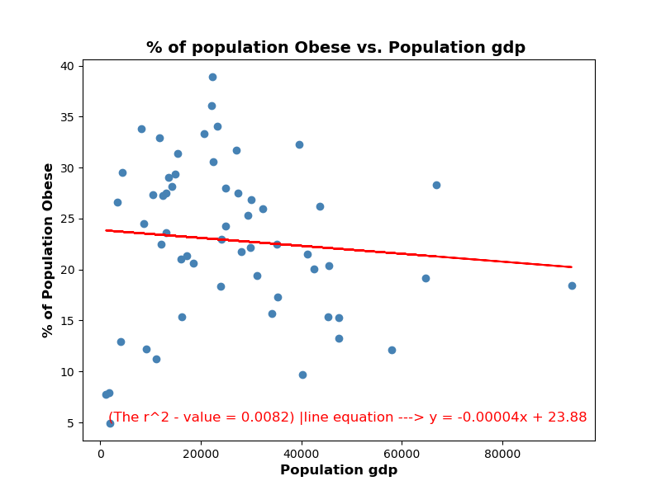
Q6: Is there a correlation between global income levels and obesity rates?
The scatter plot analysis yields an r² value of 0.008, indicating no significant correlation between global income levels (GDP) and obesity rates. This suggests that income alone is not a strong predictor of obesity, and a more nuanced analysis that includes additional factors is needed to understand the relationship between economic conditions and obesity.

Slide 22
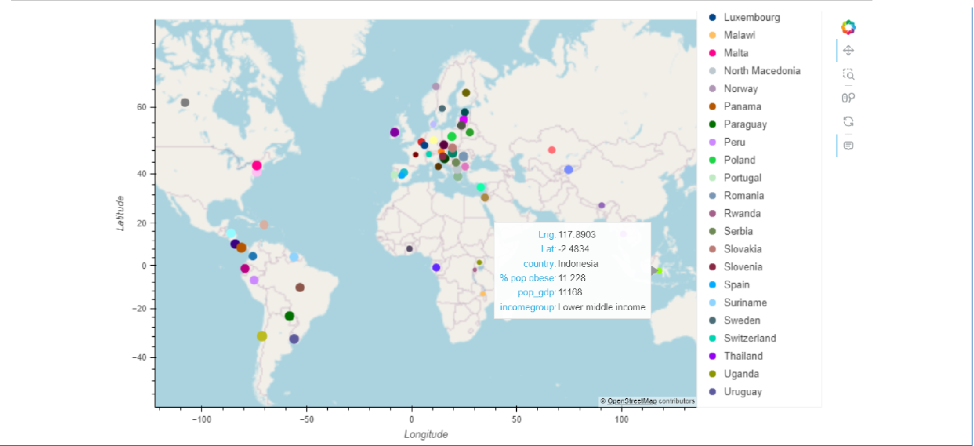
Map showing prevalence of obesity globally

Slide 23
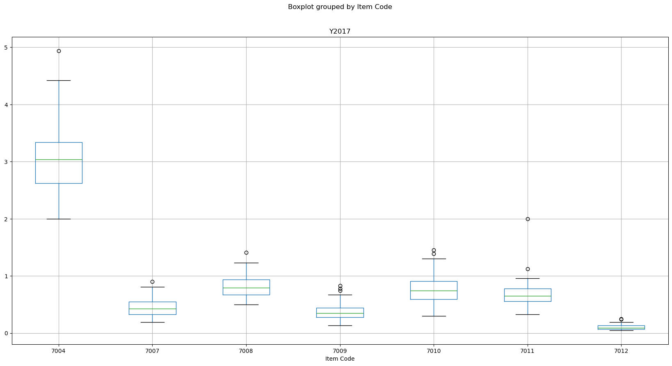
Statistical
tests
(ANOVA)
F-statistics: 727.28, very large, substantial differences in the average costs of the different food types.
p-value: 1.0984e-213, close to zero, the differences between the groups are statistically significant.

Slide 24
Hypothesis Testing using ANOVA
We decided to test an hypothesis using ANOVA to evaluate whether variations in the varying costs of food categories significantly impact the overall cost of a healthy diet.
NULL HYPOTHESIS:
There is no significant difference in the cost of a healthy diet concerning the various food categories.
The ‘means’ of the costs associated with these food categories are equal, indicating that the cost of a healthy diet does not depend on the type of food category considered.

Slide 25


06
Conclusion

Slide 26
Conclusion
Income disparities significantly impact the affordability of healthy diets, with higher-income countries showing a lower percentage of populations unable to afford healthy diets and lower costs associated with these diets.
However, the cost of animal-based foods remains a considerable burden for lower-income groups, particularly in low- and middle-income countries.
While income is a key factor influencing dietary choices, it only has a weak correlation with obesity rates, suggesting that other factors, such as lifestyle and culture, may also influence obesity prevalence.
Further research is needed to explore the broader determinants of obesity and dietary choices across income groups.

Slide 27
Bibliographical references
Global income statistics https://www.kaggle.com/datasets/konradb/global-income-statistics
Cost and Affordability of a Healthy Diet (CoAHD) https://www.fao.org/faostat/en/#data/CAHD
NCD Data Portal - WHO http://ncdportal.org/
Slidesgo - https://slidesgo.com/faqs and https://slidesgo.com/slidesgo-school

Slide 28

Thanks!
Please keep this slide for attribution

Slide 29
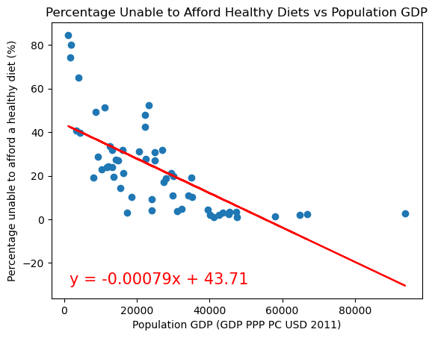
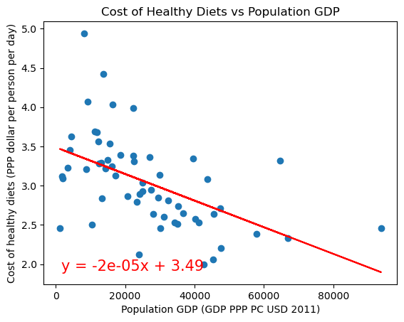
The r²-value is 0.481
The r²-value is 0.277

Slide 30
Resources
Did you like the resources on this template? Get them for free at our other websites.
Photos
Real food pyramid assortment
Real food pyramid assortment 1
Top view real food pyramid
Real food pyramid assortment top view
Real food pyramid arrangement still life
Plus-size woman eating at a restaurant alone
Plus-size woman eating at a restaurant alone 1
Plus-size female friends spending time together at a restaurant
Side view woman with banana slices
Close up smiley woman and man at restaurant
Woman eating a lettuce salad
Afro american woman eating vegan salad
Senior woman making dish with figs in the kitchen
Icons
Icon Pack: Healthy Food | Lineal

